Slide 1
TRansition
From a to b To c without a hitch?
Chris Chivers

Slide 2
Transition
Common features?
Known to unknown.
Adjustment, breaking attachments
Changed expectations (adult/teacher/school)
Altered social groups.
Dislocation.
Insecurities.
Specific personal needs.

Slide 3
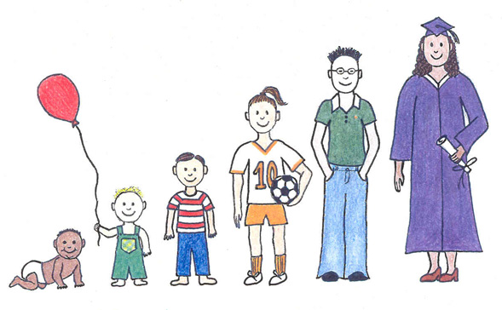
Life’s complex and has stress points
Home to ANOther.
Home to pre-school.
Pre-school to EYFS.
EYFS to Infants (KS1)
Infants (KS1) to Juniors (KS2)
Juniors (KS2) to Secondary (KS3)
KS3 to KS4 (GCSE)
KS4 to KS5
University
Work
Transition Transfer
Induction?
Settling period?
Mentoring?

Slide 4
From well known to unknown; continuity and progression?
By July, a Primary class teacher will know their children inside-out, across a wide spectrum of achievements.
In September, the receiving teacher will not know them in as much detail and the teacher(s) may be unknown to the children.
Constants should include; behaviour expectations, curricular continuity in areas such as reading & shared personal learning achievements and needs.
Teacher awareness and engagement (TS6) should support evidenced adaptations (TS5) to needs. September likely to be high priority.
Planned settling back/in period? Long term planning. (TS4)
Restoring status quo from July/ recalibration of expectations?

Slide 5
Information Exchange
Continuity and progression, or discontinuity and regression?
Understanding prior approaches; professionalism?
Data may not describe the whole child.
Personal and individual?
Curricular achievements? Selective portfolio, or work example. or continue to work in same books from year end to year beginning?
Curricular; personal learning targets/gaps/needs…
Additional achievements?
Issues?
How to ensure rapid recovery to July performance levels? (TS6,5&2)
Re-establishing expectations; behaviour and curriculum? (TS1,7)

Slide 6
Transition point; In-school/ between schools
Good transition is an ethos thing…
Good transition is what good schools and teachers do…
Good transition ensures continuity and progression.
Talk together, so that the receiving school:-
Understands the earlier contexts
Accepts prior professional judgements through moderation activity.
24652

Slide 7
How good is transition, transfer and induction? Do you Ask Them?
Participants; parents, children and teachers.
Quality and accessibility of communication and paperwork.
Timing of meetings prior to and during transition.
Induction day(s).
Impact assessment?
WWW and EBI question?
Specific adaptations for vulnerable children?
What about in-year transition?
Evaluation, reflection, feedback and alterations?
Communicate
“You said,
we thought, we decided.”

Slide 8
George Bernard Shaw
The only man I know who behaves sensibly is my tailor; he takes my measurements anew each time he sees me. The rest go on with their old measurements and expect me to fit them.

